Slide 1


Encrypted Multi-Party Container Load Optimization with RAG-Powered Compliance Explanations
SIMATS ENGINEERING Saveetha Institute of Medical and Technical Sciences Chennai-602105.
Presented by
K sreelatha(192425248)
P Ishwariya(192524445)
Angel Deepika M(192521272)
G Navya sri(192524170)
C Manogna(192525215)
Guided By:
Dr.A.Sairam

Slide 2
Introduction
Encrypted Multi-Party Container Load Optimization is an intelligent logistics approach for optimizing the arrangement of cargo inside shipping containers.
It enables multiple stakeholders such as exporters, importers, freight forwarders, shipping companies, and customs authorities to collaborate securely.
Sensitive information such as cargo details, weight, dimensions, quantity, and business data can be protected using encryption techniques.
The system optimizes container loading based on available space, weight capacity, cargo dimensions, and transportation constraints.
It aims to maximize container space utilization while minimizing unused space and transportation costs.
Retrieval-Augmented Generation (RAG) is used to retrieve relevant shipping regulations, customs rules, safety requirements, and compliance documents.

Slide 3
Problem Statement
When multiple shipping companies consolidate cargo into shared containers to reduce costs, they must disclose sensitive manifest details (cargo type, weight, value, destination) to a shared platform or to each other — creating competitive and security risks. Additionally, existing load-planning systems optimize space/weight but give no human-readable justification for why a load plan was structured a certain way, forcing logistics staff to manually cross-check complex, ever-changing shipping regulations (hazard separation rules, weight limits, customs restrictions) after the fact. There is no existing system that combines privacy-preserving multi-party optimization with automated, regulation-grounded explanation generation.

Slide 4
Objectives
Design a system where multiple companies can identify compatible cargo for container consolidation without exposing raw manifest data to each other or the platform.
Implement encrypted approximate nearest-neighbor matching (LSH + distance-preserving encryption) to find cross-company cargo compatibility in encrypted space.
Build a hybrid Dynamic Programming + Greedy optimizer to compute the optimal multi-constraint container load plan from matched compatible cargo.
Integrate a Retrieval-Augmented Generation (RAG) layer that retrieves relevant shipping regulations and generates a plain-English compliance explanation for each load plan.
Ensure each participating company can decrypt and view only their own portion of the final load plan and explanation.

Slide 5
Proposed System
ConstraintVault is a privacy-preserving logistics platform where each company's cargo details are converted to feature vectors and encrypted client-side before ever reaching the server.
The server performs LSH-based approximate matching entirely in encrypted space to cluster compatible cargo across companies, without decrypting any manifest.
The matched cargo set is passed to a DP+Greedy multi-constraint knapsack optimizer that computes the optimal joint load plan under weight, volume, and hazard-separation constraints.
A RAG layer then retrieves relevant regulation/SOP clauses (embedded using the Gemini API) via encrypted search and uses Gemini's generation model to produce a natural-language compliance explanation citing the retrieved rules.
Each company decrypts and views only their own load plan segment and explanation.

Slide 6
Scope & Requirements
Scope:
Applicable to freight consolidation scenarios involving 2+ shipping companies sharing container space; covers cargo matching, load optimization, and compliance explanation generation; prototype scope limited to a defined regulation corpus (e.g., IMDG hazard classes, standard SOPs).
Functional Requirements:
Client-side cargo feature encoding and encryption moduleServer-side encrypted LSH compatibility searchDP+Greedy load optimization engineRegulation embedding + encrypted retrieval + Gemini-based explanation generationCompany-scoped decryption and dashboard views
Non-Functional Requirements:
No plaintext cargo data ever stored or processed server-sideLoad plan computation within interactive time boundsExplanation generation grounded only in retrieved regulation context (no unsupported claims)Multi-tenant data isolation across companies
Hardware/Software Requirements:
Python 3.x, FastAPI, NeonDB (Postgres + pgvector), Gemini API access, React/Vite frontend, standard cloud/college server for deployment.

Slide 7
Methodology
Each company inputs cargo details (weight, volume, hazard class, fragility, destination, priority); these are converted into numeric feature vectors client-side.Feature vectors are LSH-bucketed and encrypted (ASPE) before transmission.
Server performs encrypted approximate nearest-neighbor matching across companies' encrypted vectors to identify compatible cargo clusters, without decryption.
Matched compatible cargo is passed to the DP+Greedy knapsack optimizer, which computes the space/weight-optimal joint load plan under hard constraints (hazard separation, capacity limits).
The finalized load plan is used as a query context; relevant regulation/SOP documents (pre-embedded via Gemini embedding API) are retrieved through encrypted LSH search.Retrieved regulation clauses + load plan data are passed to the Gemini generation model to produce a plain-English compliance explanation with cited sources.
Each company decrypts and receives only their own portion of the load plan and its explanation via their client-side module.System is evaluated on: match/retrieval recall, optimizer utilization %, and explanation groundedness (whether generated text matches retrieved sources).

Slide 8
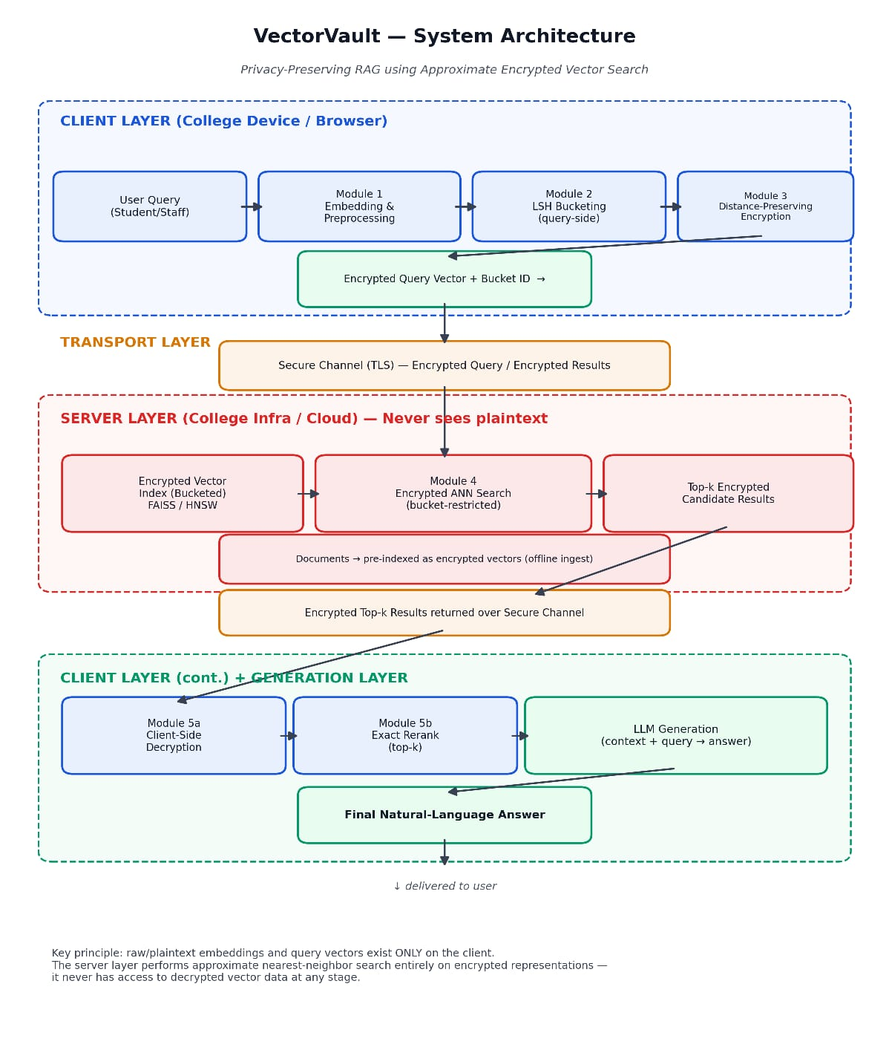
System Architecture

Slide 9
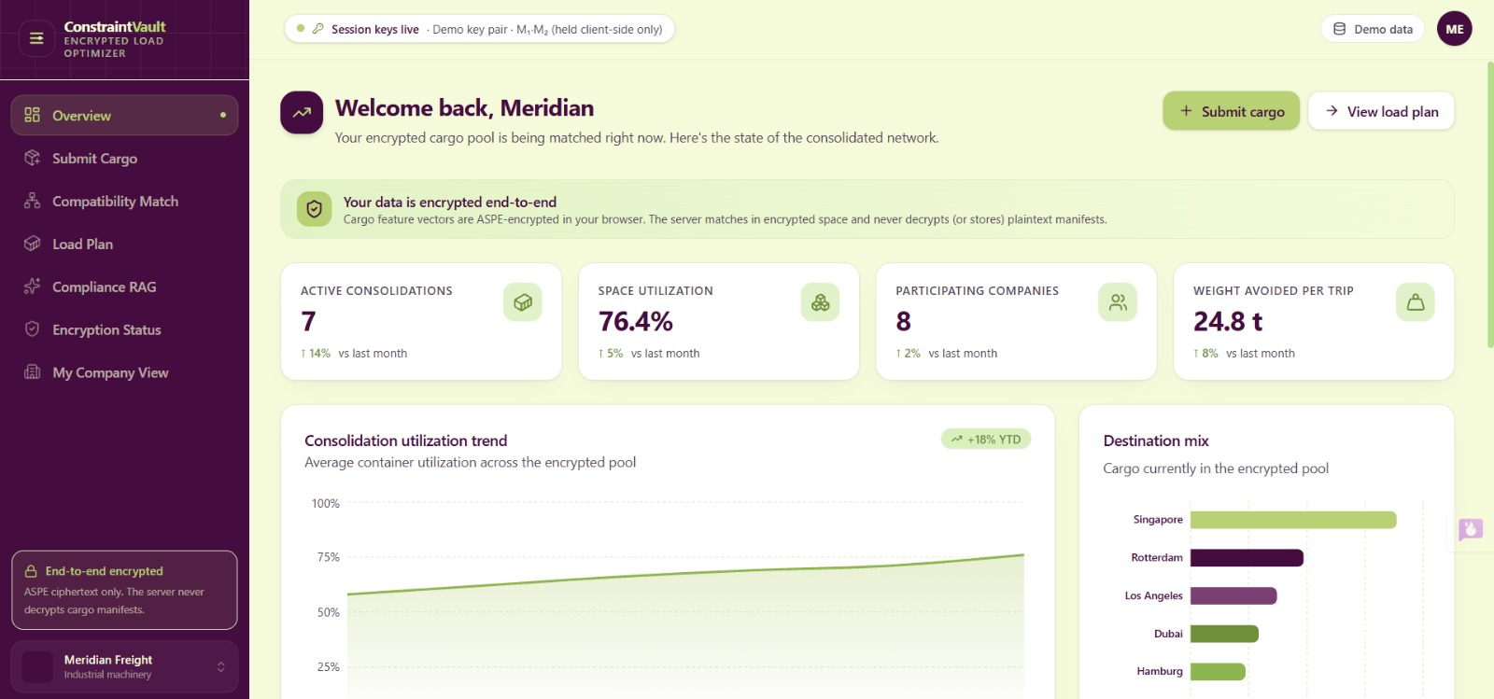
Module 1: Cargo Feature Embedding, LSH Bucketing & Encryption
Converts each company's raw cargo details (weight, volume, hazard class, fragility, destination, priority) into structured numeric feature vectors, applies Locality-Sensitive Hashing to bucket potentially compatible cargo, and encrypts the vectors client-side using an ASPE-based distance-preserving encryption scheme — ensuring no raw manifest data ever leaves the company's device unprotected.

Slide 10
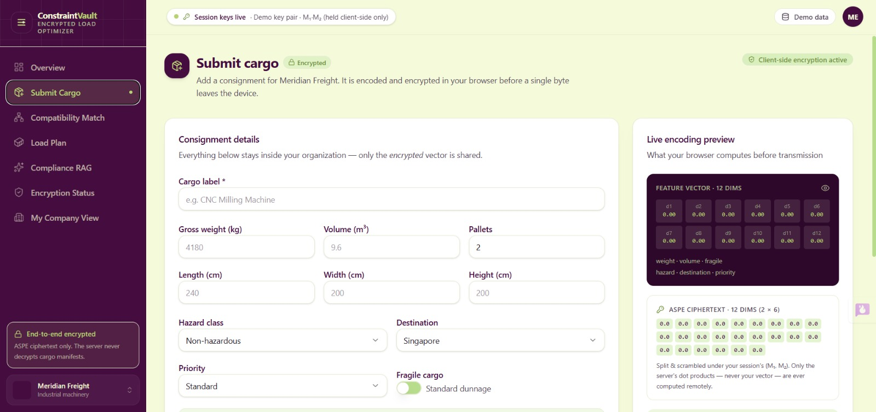
OUTPUT

Slide 11
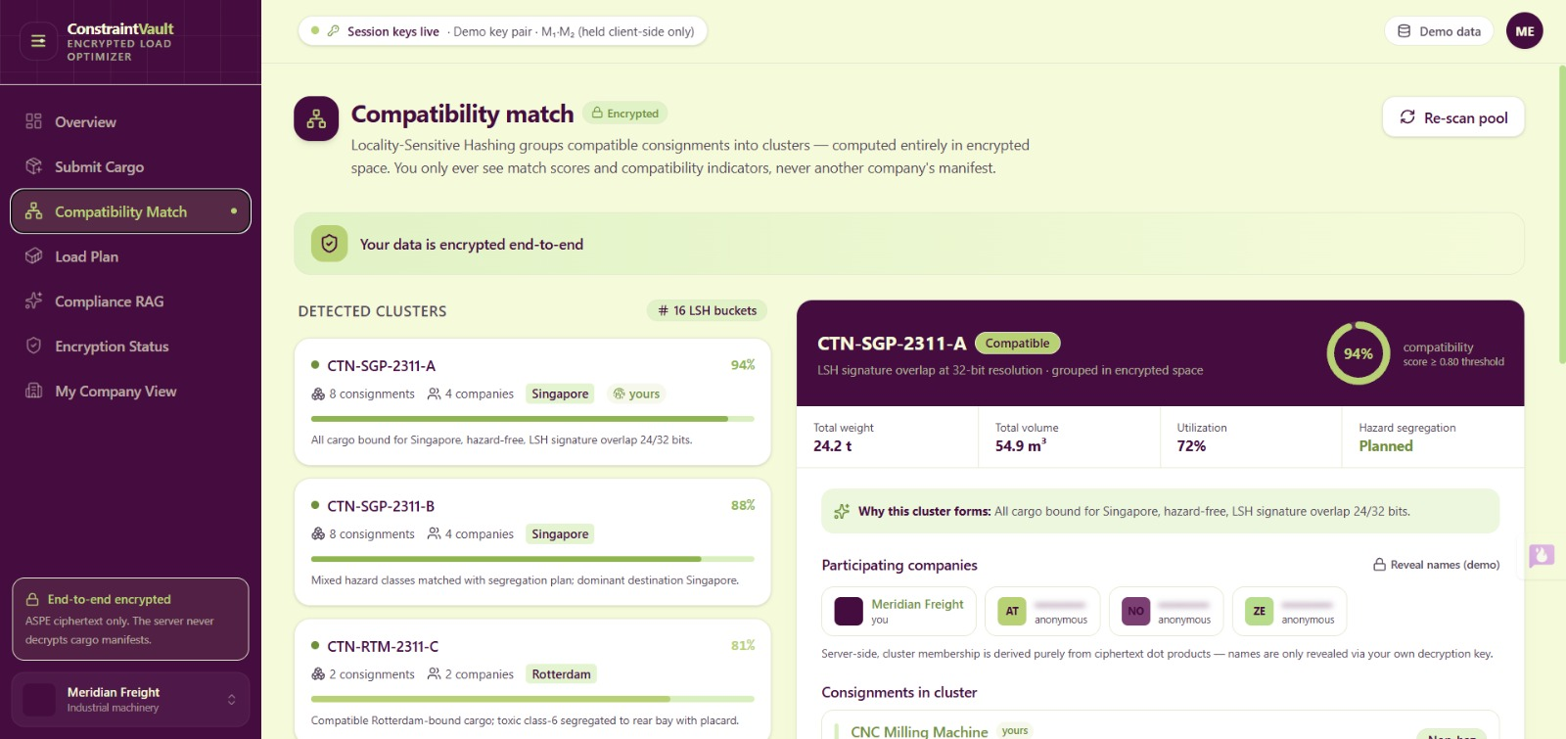
Module 2: Encrypted Cross-Company Compatibility Search
Performs approximate nearest-neighbor matching entirely on encrypted, bucketed vectors across multiple companies' data, identifying compatible cargo clusters for consolidation without ever decrypting any party's manifest on the server.

Slide 12
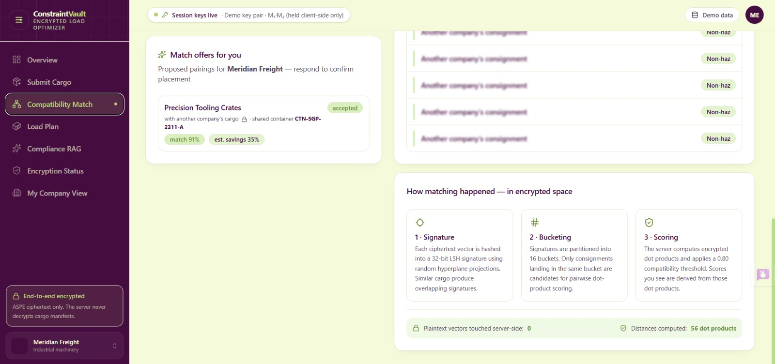
Module 3: DP + Greedy Multi-Constraint Load Optimizer
Takes the matched compatible cargo clusters and computes the optimal joint container load plan using a hybrid Dynamic Programming + Greedy algorithm, maximizing space/weight utilization while satisfying hard constraints such as hazard separation, weight limits, and volume caps.

Slide 13
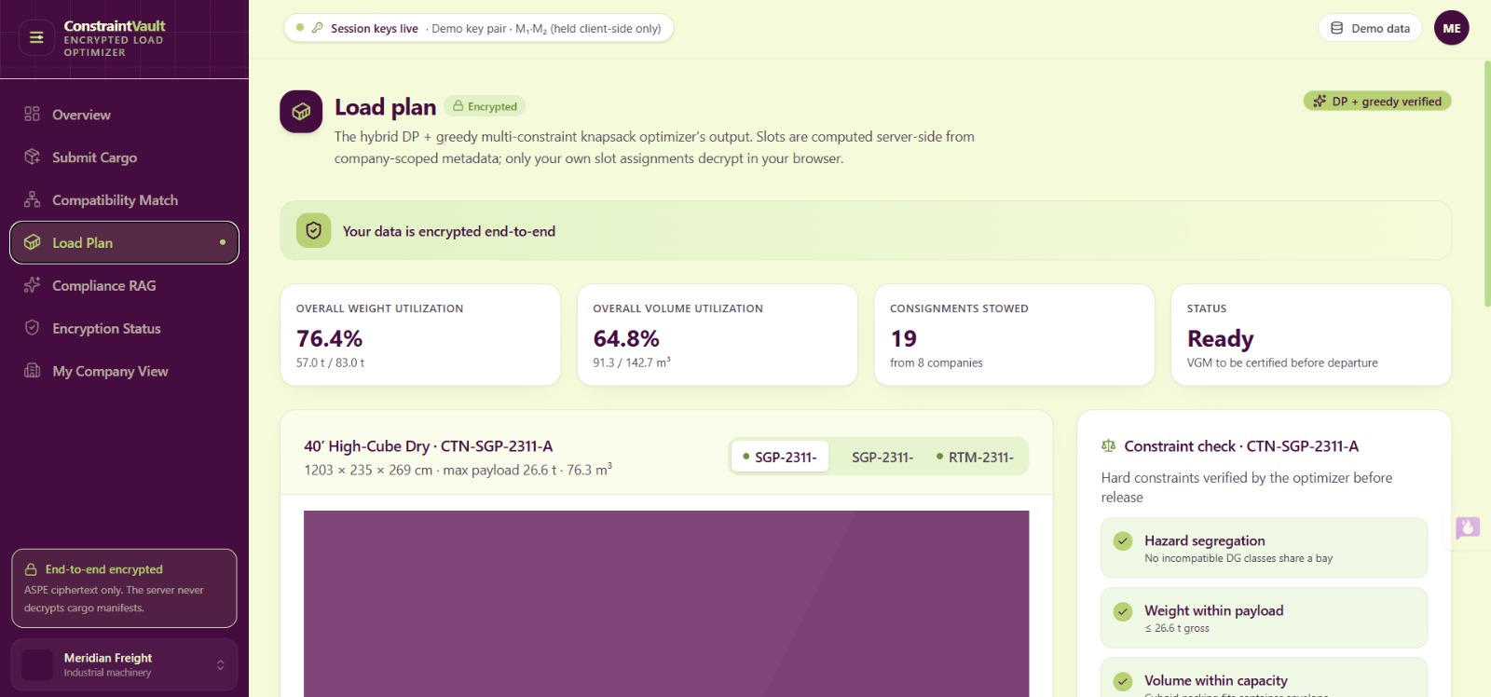

Slide 14
Module 4: RAG Compliance Explanation Module
Embeds the shipping regulation/SOP corpus using the Gemini embedding API, retrieves the most relevant regulatory clauses via encrypted LSH search based on the finalized load plan, and uses the Gemini generation model to produce a plain-English compliance explanation citing the retrieved sources.

Slide 15
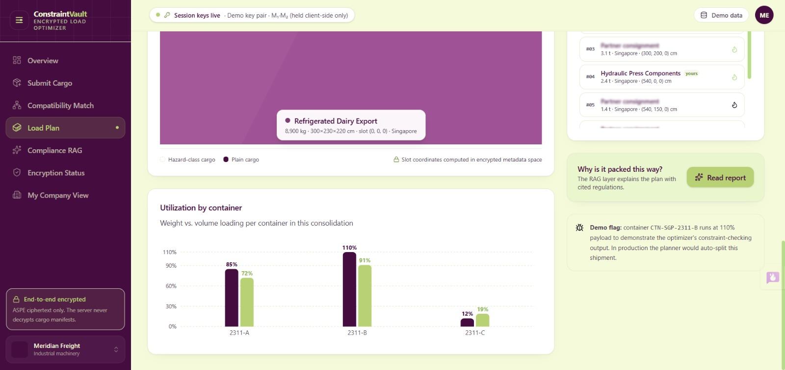
Module 5: Client-Side Decryption & Company-Scoped Results
Decrypts and delivers only the requesting company's own portion of the final load plan and its compliance explanation, ensuring complete data isolation and zero cross-company leakage at every stage of the pipeline.

Slide 16
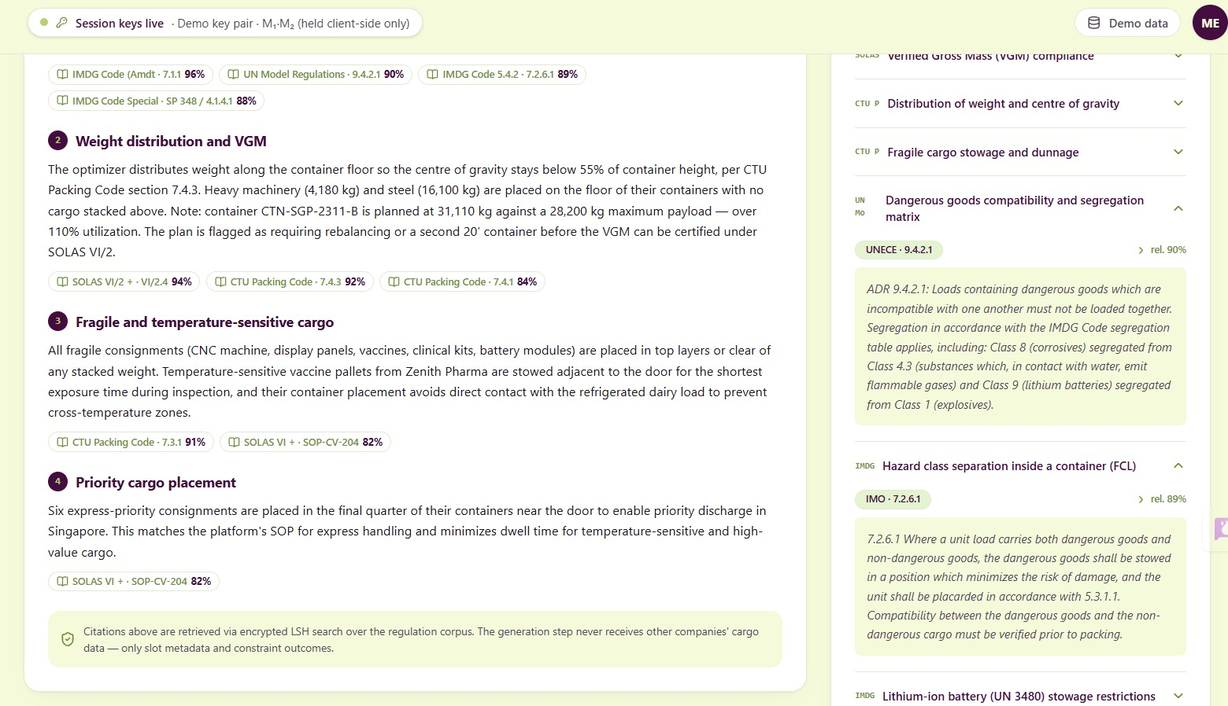

Slide 17
Conclusion
ConstraintVault demonstrates that privacy-preserving multi-party optimization and explainable AI can coexist within a single logistics system. By combining encrypted approximate matching, hybrid DP+Greedy optimization, and a RAG-based explanation layer, the system enables competing shipping companies to consolidate freight efficiently and transparently — without exposing sensitive data — while giving logistics staff clear, regulation-grounded justifications for every load plan decision.

Slide 18
References
Lewis, P. et al. "Retrieval-Augmented Generation for Knowledge-Intensive NLP Tasks," 2024.Indyk,
P., & Motwani, R. "Approximate Nearest Neighbors: Towards Removing the Curse of Dimensionality," 2024.Gentry,
C. "A Fully Homomorphic Encryption Scheme," 2024.Wong, W.K. et al. "Secure kNN Computation on Encrypted Databases" (ASPE), 2023.FAISS: Johnson, J., Douze,
M., Jégou, H. "Billion-scale similarity search with GPUs," 2024.
Google AI. "Gemini API Documentation — Embeddings and Generation Models."Johnson, J., Douze, M., Jégou, H. "Billion-scale similarity search with GPUs," 2024.

Slide 19


